Slide 1
Classical MD simulations
Miguel A. Gonzalez
Institut Laue-Langevin, Grenoble (France)

Slide 2
Plan
Introduction
Do we need simulations? Why?
What kind of simulations?
Representing intermolecular forces
Electronic structure methods → Density functional theory (DFT)
Force fields
Coarse grained models
Sampling phase space
Lattice Dynamics
Monte Carlo
Molecular Dynamics
Software
Analysis
What can we get from a simulation?
Comparing simulation and experiment
Difficult problems
Some useful tools
Examples
Using simulations to understand neutron scattering
Using neutron data to improve force fields

Slide 3
Introduction
Do we need computer simulations?
EXCELLENT COMPUTER SIMULATIONS ARE DONE FOR A PURPOSE. THE MOST VALID PURPOSES ARE TO EXPLORE UNCHARTED TERRITORY, TO RESOLVE A WELL-POSED SCIENTIFIC OR TECHNICAL QUESTION, OR TO MAKE A GOOD DESIGN CHOICE.
Leo P. Kadanoff: “Excellence in computer simulation”, Comp. Sci. Eng. 6, 57-67 (2004).
Only in rare cases simulations have discovered new phenomena (e.g. long time tails)
Typical role is to work with theory and experiment and serve to test models and theories in order to understand a given phenomenon
Caution: Quite often simulations can be wrongly used to support previous conclusions
“Experiment is very good at finding unexpected behavior and describing its overall characteristics; theory often can explain what’s going on. After an appropriate pause for algorithm development, simulations then can test the ideas and fill in the details.”
Notes:
(kadanoff04) Simulations and computer modelling play an increasingly important role in all aspects of our lives, and science is not an exception. But the first question is if we really need them and what can they provide. This paper by Leo Kadanoff provides some answers to this question. The short abstract reads … Then he mentions some of the nicest examples of the application of simulations in different scientific fields, but he also points the limitations. For example, only in a few rare cases simulations have been at the origin of new discovery. The development of chaos theory is one of these examples, as well as the discovery of long time tails in the VACF of fluids. This was discovered in one of the first MD simulations and remained a surprise and a mystery for some time, until it was understood later as a consequence of hydrodynamic flow. But those are exceptions, and in most of the cases the usual role of the simulation is to complement theory and experiment. And when doing this, we need to be very careful to avoid being biased by our expectations, as there are many examples of simulations used to support experimental interpretations that were found to be wrong later. So we have to be careful, but simulations can be very helpful when used wisely together with experiment and theory, and Kadanoff gives a nice summary with this sentence: …

Slide 4
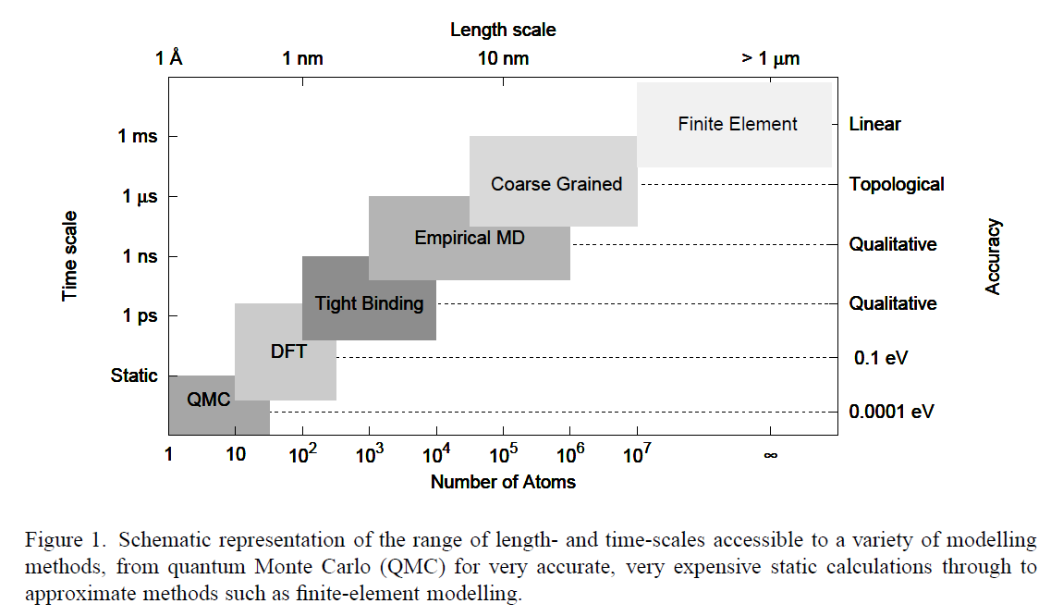
Introduction
What kind of simulations? Compromise: Accuracy vs efficiency
From Kermode et al., in Multiscale Simulation Methods in Molecular Sciences,
J. Grotendorst, N. Attig, S. Blügel, D. Marx (Eds.), NIC Series, Vol. 42, pp. 215-228 (2009).
Notes:
So if we decide that we need to simulate our system, or that a simulation could help us, then the next question is: What kind of simulation? There are many possibilities, and as expected, the most accurate ones are the most computationally expensive, meaning that we can apply them only to small systems and few configurations. By loosing accuracy and decreasing the level of detail (e.g. renouncing to describe the electrons and using an empirical potential instead, of renouncing to a full atomic description of the system and replacing several atoms by a larger blob), we can increase considerably the time and length scales. Finally using finite element methods we can reach macroscopic scales. For neutron scatterers, the most useful tools are DFT and empirical MD, and the final choice will depend on the size of the system to study, the properties in which we are interested, and the time and resources available.

Slide 5
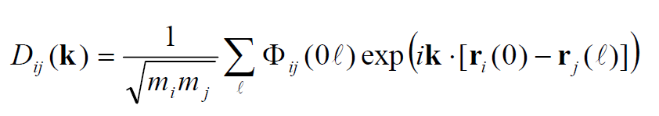
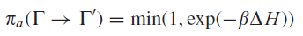
Introduction
What kind of simulations?
Choose way of computing
interatomic forces
Choose way of sampling
the phase space
Lattice Dynamics
Hartree-Fock methods
Semiempirical methods
Density Functional Theory
Tight-binding
Empirical force fields
Coarse graining
Thermodynamics
Phonons
Monte Carlo
Thermodynamics
Structure
Brownian Dynamics
Langevin Dynamics
Dissipative Particle Dynamics
Molecular Dynamics
Notes:
Basically we have two almost independent choices. First the method that we want to use to treat the intermolecular and interatomic forces (compromise accuracy/efficiency). And then the method that we want to use to sample phase space. The choice will depend mainly on the kind of properties we are interested in. E.g., LD will be the more efficient to get the phonon dispersion curves in a crystal, and from this the main thermodynamic properties. The main limitation is then that we assume the validity of the harmonic approximation. MC is the best method to compute structural and thermodynamic properties, as well as to explore different thermodynamic ensembles. But dynamic properties can not be calculated using MC. For this, we will need MD, which is the more general method.
Finally there are other methods a little bit apart, where the basic approach consists in removing completely the fast degrees of freedom, typically associated with the solvent, which are substituted by stochastic terms in the equations of motion. E.g. the solvent is mimicked by a friction coefficient and a random noise. Subtle differences between them, but not going into this (schiller_thesis_DPD).

Slide 6
Computing energies and forces
Using empirical potentials

Slide 7
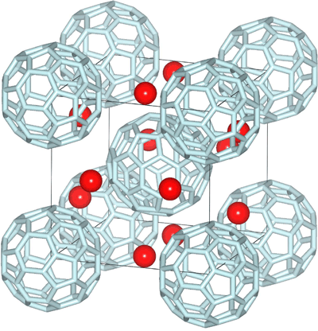
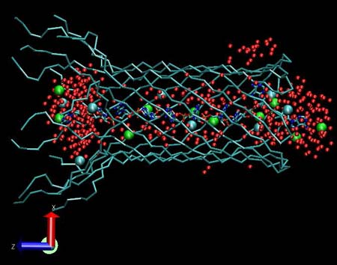
Molecular Mechanics approach
No electrons
Molecules represented as ‘balls’ + ‘springs’
Empirical potential to account for intra- and intermolecular interactions
→Force Field (FF)
~5-6 orders of magnitude faster than DFT → ~10⁴-10⁵ atoms, ~1-100 ns

Slide 8
What is a Force Field?
A mathematical expression describing the dependence of the energy of a system on the coordinates of the atoms
Consists of:
An analytical form of the interatomic potential energy, U(r₁...r_{N})
A set of parameters entering U(r₁...r_{N})
The parameters are obtained from ab initio calculations and/or fitting to experimental data
Molecules are defined as collection of atoms held together by simple elastic (harmonic) forces

Slide 9
A standard FF

Slide 10
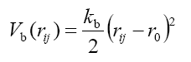
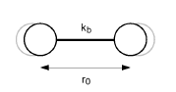
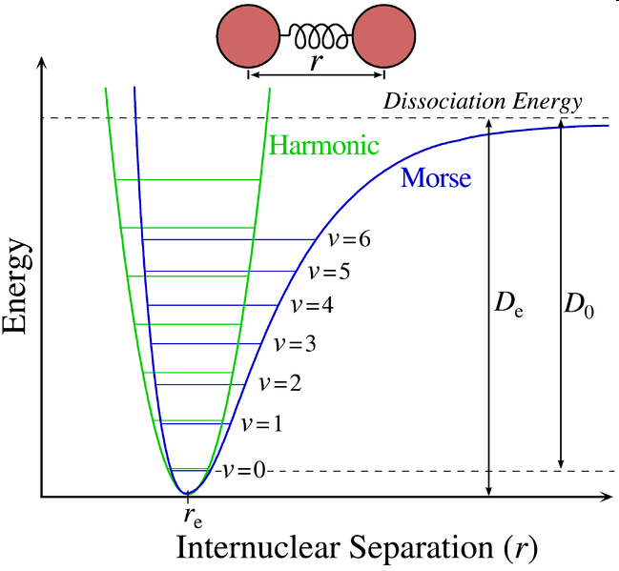
Intramolecular terms: Bonding
Very often, represented by a simple harmonic function:
• This is a poor approximation at large values of r_{ij}, but at normal temperatures r_{ij} is small (stiff bonds)
• Other functional forms used occasionally, in particular we can employ the Morse potential to improve the accuracy (at the cost of slowing the calculation)

Slide 11
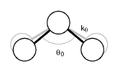
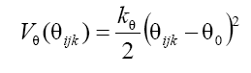
Intramolecular terms: Bending
• Again represented usually by a harmonic function:
• Bending constants, k_{θ} , are normally smaller than stretching constants k_{b} by a factor 5 to 10
In CHARMM FF, there is an additional term, called Urey-Bradley, introduced to optimize the fit to vibrational spectra:
∑
1
V
=
k
(
s
−
s
)
2
s: distance between 1,3 atoms (separated by 2 bonds)
UB
2
UB
0
UB

Slide 12
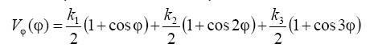
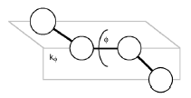
Intramolecular terms: Torsion
• Typically represented by cosine functions:
• Torsional motions are typically hundreds of times less stiff than bond stretch
• They ensure correct degree of chain rigidity
• Necessary to reproduce major conformational changes

Slide 13
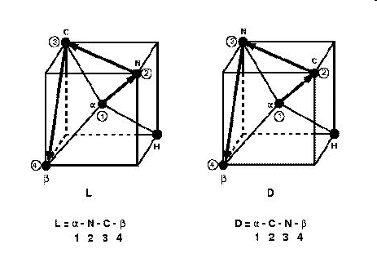
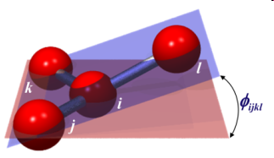
Intramolecular terms: Improper torsion
Used to describe the energy of out-of-plane motions
Often necessary for planar groups, such as sp² hybridized carbons in carbonyl groups and in aromatic rings, because the normal torsion terms described above is not sufficient to maintain the planarity
Also needed sometimes to define chiral molecules

Slide 14
Intermolecular terms: Van der Waals
• Van der Waals interactions between two atoms arise from the balance between repulsive and attractive forces:
Repulsion is due to overlap of electron clouds of two atoms
Attraction is due to the dispersion or induced multipole interactions (dominated by induced dipole-dipole interactions)
• Very often they are represented by the Lennard-Jones potential
• We will have VdW interactions between all atoms that are not directly bonded: atoms belonging to different molecules but also between atoms of same molecule but separated (often, but not always) by more than 3 bonds (> 1-4 interactions)
Notes:
Scanning instruments and instrument 2.0 is a must for Ian

Slide 15
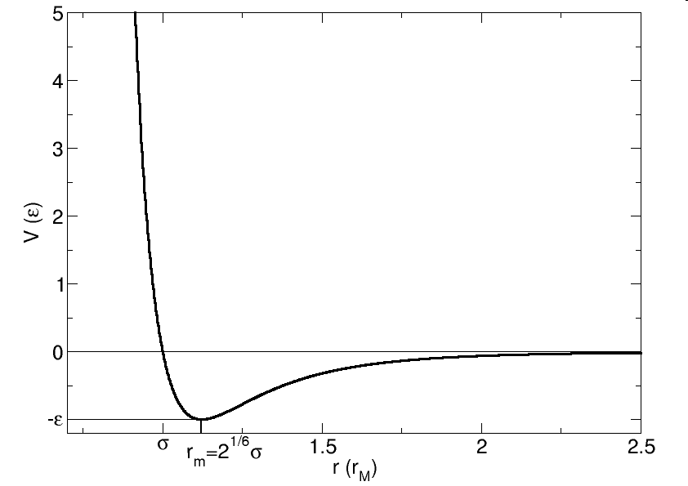
VDW: Lennard-Jones
Calculated pairwise but parameterized against experimental data → includes implicitly many-body effects
Use of r⁻¹² for the repulsive term due to computational convenience
Other functions in use, but less popular because of higher CPU cost:
(less repulsive, used for some inorganic systems)

Slide 16
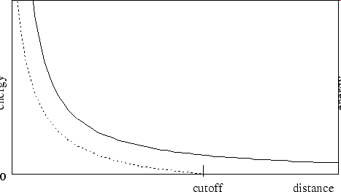
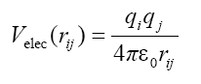
Intermolecular terms: Electrostatics
• Electrostatic interactions between charged atoms and dipolar
groups are normally treated by assigning a point charge (partial
charge) to each atom and then using Coulomb’s law:
• In standard models, the charges assigned are effective charges,
i.e. they include polarization effects appearing in condensed
phases (e.g. for water, μ_{models} = 2.3-2.7 D while μ_{H2O, gas} = 1.8 D)
• Long-ranged: decay as 1/r (charge-charge) or 1/r³ (dipole-dipole) → Care with truncation!

Slide 17
Non-bonding exclusions
Partition of potential energy in different terms is arbitrary!
Which intramolecular pairs should we include in the sum of VdW and electrostatics energies?
Possible problems:
Small r_{ij} → large non-bonding interactions
Already bonding terms (bonds, angles, dihedrals) between them
Non-bonded exclusions: VdW and Coulomb interactions calculated only for pairs not involved in direct bonding interactions.
Number and type depend on the FF. Typically:
1-2 and 1-3 interactions excluded
1-4 interactions partially excluded
Combination of dihedral + 1-4 VdW & electrostatics will determine rotational barriers → care if mixing parameters from different FFs!
l
1-4
1-3
i
k
1-2
j

Slide 18
Special terms
Not commonly used and not available in all MD software
U_{total} = U_{intramol} + U_{cross-term} + U_{non-bond}
U_{cross-term} = U_{bond-bond} + U_{bond-bend-bond} + U_{bend-bend} + U_{dihedral-bond} + ...
U_{non-bond} = U_{vdW} + U_{qq} + U_{pol} + U_{HB}
U_{cross} brings corrections to energy due to couplings between stretches, bends, and torsions, e.g:
U_{HB} may improve the accuracy of H-bonding energy:

Slide 19
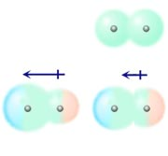
Adding the effect of polarizability
Surrounding molecules will induce a charge redistribution
This can be modelled using fluctuating charges, shell models (Drude particle) or induced point dipoles
Iterative calculation:
- Evaluate induced dipoles due to permanent charges
- Adjust charges or reevaluate induced dipoles due to q+μ^{ind}
- Repeat until convergence
- Reiterate every time one molecule is moved

Slide 20
Polarizable FFs
Very important to increase transferability
But FF is a global entity → adding polarizability needs re-optimizing VDW and intramolecular parameters
As a consequence they are not so matured as non-polarizable and in some cases (e.g. water) results are not better
But it is agreed that they will be able to provide better agreement with experiment than non-polarizable FF (Cieplak et al., J. Phys.: Condens. Matter 21, 333102 (2009))
Polarizable FFs: PIPF, DRF90, AMOEBA, XPOL + some of the classical FFs (CHARMM, AMBER, OPLS, GROMOS)

Slide 21
FF parameterization
An elaborate job
Goal: Describe in classical terms the quantum mechanical facts by partitioning the total electronic energy into well separated atom-atom contributions
As it is impossible to fully separate the intricate electronic effects, this means applying significant approximations → empirical potentials
We will obtain different FFs depending on the set of data (experimental or QM calculations) and the procedure employed to optimize the parameters
“FF development is still as much a matter of art as of science” (T. Halgren, Curr. Opin. Struct. Biol., 1995)

Slide 22
FF parameterization
Components
Functional forms of the components of the energy expression
A list of atom types
A list of atomic charges
Rules for atom types
A set of parameters for the function terms
(Rules to generate parameters that have not been defined explicitly)
Generally developed by specialized groups and available in the literature as data tables

Slide 23
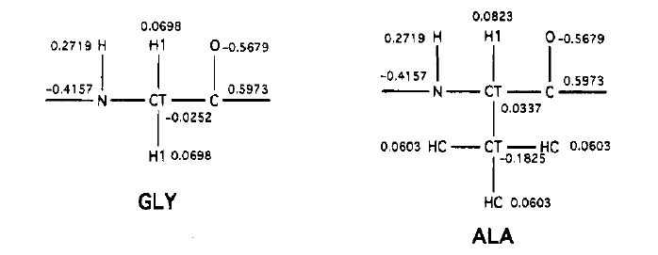
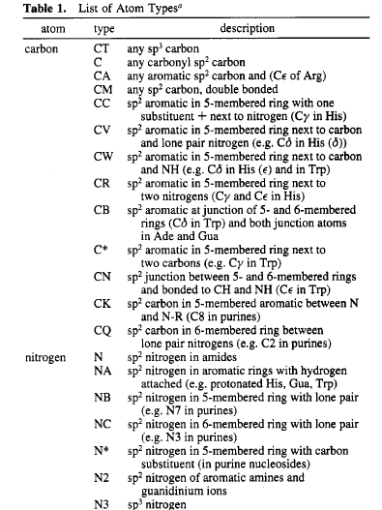
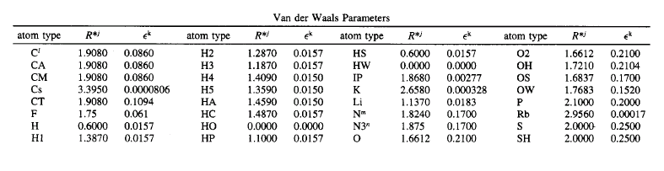
FF example
Amber

Slide 24
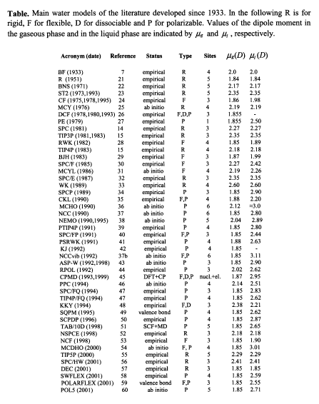
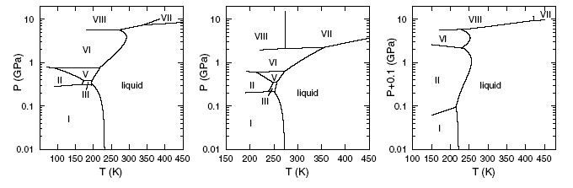
Choosing a FF
Highly subjective, e.g. water case
Sanz, PRL (2004)
TIP4P
Exp
SPC/E
But ...
D_{SPC/E} = 2.49, D_{TIP4P} = 3.29, D_{exp} = 2.4 (10⁻⁵ cm²/s)
ε_{SPC/E} = 71, ε_{TIP4P} = 53, ε_{exp} = 78
Guillot, J. Mol. Liq. (2002)

Slide 25
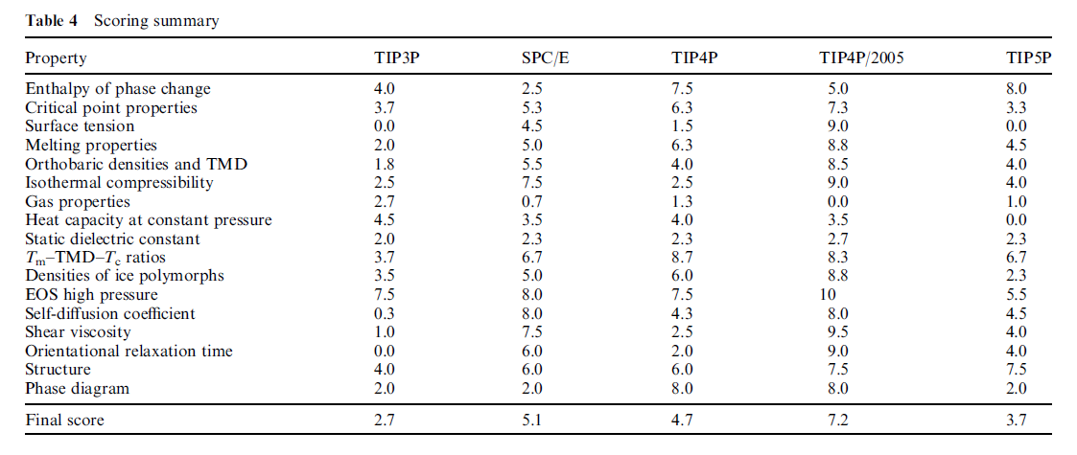
Choosing a FF
Highly subjective, e.g. water case
Compute 17 different properties and note each of them
TIP4P/2005 is probably close to the best that can be achieved with a rigid non-polarizable model
Vega & Abascal, Phys. Chem. Chem. Phys. 13, 19663-19688(2011)

Slide 26
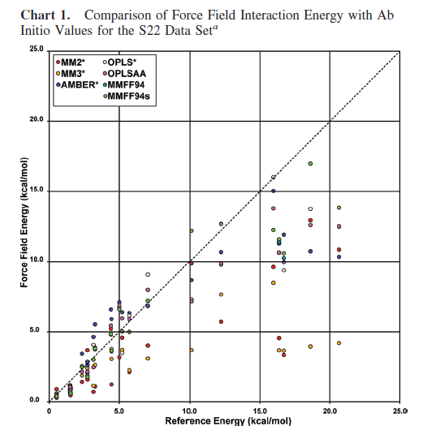
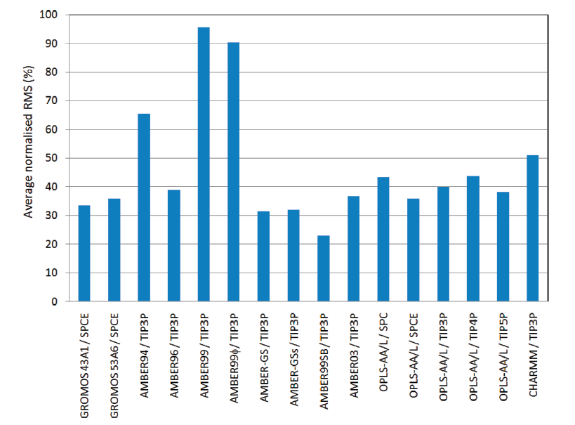
Choosing a FF
Paton & Goodman, J. Chem. Inf. Model 49, 944-955 (2009)
Highly subjective
Aliev & Courtier-Murias, JPCB 114, 12358-12375 (2010)

Slide 27
Choosing a FF
Highly subjective
“All leading force fields now provide reasonable results for a wide range of properties of isolated molecules, pure liquids, and aqueous solutions”, Jorgensen & Tirado-Rives, PNAS 102, 6665 (2005).
But the best force field does not exist!
Choice will depend on the type of molecular system and the type of properties we are interested in!

Slide 28
Force fields
Summary
The FF must be simple enough to be evaluated quickly, but sufficiently detailed to reproduce the main features of the system
They are constructed by parameterising a potential function using either experimental data (n, X-R and e⁻ diffraction, NMR, IR, Raman and neutron spectroscopy) or ab-initio and semi-empirical quantum mechanical calculations
The goal is to replace the true potential with a simplified model valid in the region being simulated
A force-field is a single entity, where the parameters are optimized in a global way. Therefore they are not strictly independent and some caution is needed before modifying one parameter or mixing parameters from different force-fields

Slide 29
FF vs DFT
Disadvantages
Intrinsic limitations:
No electronic structure information is available
Unable to handle reactions (bond breaking/forming, charge transfer, ...)
Limited prediction power:
The accuracy depends on the parameterization
It can only be used for systems having the functional groups that were included in parameterization
Limited transferability of the FF (care needed when applying a FF under conditions that are very different from the conditions used in its parameterization, e.g. P, T)
Needs experimental validation!

Slide 30
Empirical force fields
Advantages
Analysis of energy contributions can be done at the level of individual interactions or classes of interactions
Possible to modify the energy expression to bias the calculation
Allow to handle large systems and simulate relatively long times (several orders of magnitude faster than quantum-based calculations):
Small cluster (16 processors) ~ 10⁴ atoms @ 1 ns/day
BlueGene/L (131072 processors) ~ 320 billion atoms (a cubic piece of metal of side ~1 μm) @ 10 ps/day (Kadau, Int. J. Modern Physics C (2006))
Anton (specialized machine for MD simulations) ~ 10⁴ atoms @ 10 μs/day (Klepeis, Curr. Opin. Str. Biol. (2009))
NCS (256 nodes) ~ 10⁶ atoms (all-atom satellite tobacco mosaic virus, NAMD) @ 1ns/day (Freddolino, Structure (2006))
Perspectives: multimillion-atom (~100 nm scale) @ 30 ns/day on a Cray XT5 (10⁵ cores) (Schulz, J. Chem. Theory Comput. (2009))

Slide 31
Sampling phase space
using Molecular Dynamics

Slide 32

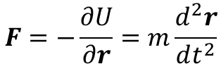
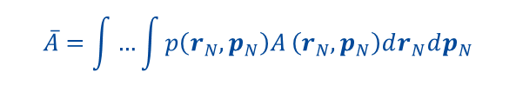
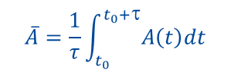
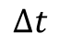
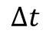
Some statistical mechanics
Impossible to explore all possible states of the system
But it is enough to generate a set of representative states
$$F=−\frac{∂U}{∂r}=m\frac{d^{2}r}{dt^{2}}$$
MD:
…
$$∆t$$
$$∆t$$
$$\overline{A}=\frac{1}{τ}\int_{t_{0}}^{t_{0}+τ}{A\left(t\right)dt}$$
MC:
…
$$\overline{A}=\int{…\int{p\left(r_{N},p_{N}\right)A}}\left(r_{N},p_{N}\right)dr_{N}dp_{N}$$

Slide 33
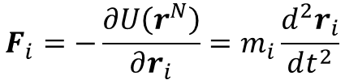
Molecular Dynamics
The basics
Generate a dynamical trajectory by integrating Newton’s equations of motion, with suitable initial and boundary conditions
We need a good way to determine the forces acting on each atom (e.g. FF or DFT)
Also need an accurate numerical method to integrate the equations of motion
$$F_{i}=−\frac{∂U\left(r^{N}\right)}{∂r_{i}}=m_{i}\frac{d^{2}r_{i}}{dt^{2}}$$
System of N coupled ODEs
No exact solution
Step-by-step numerical integration
F_{j}

Slide 34
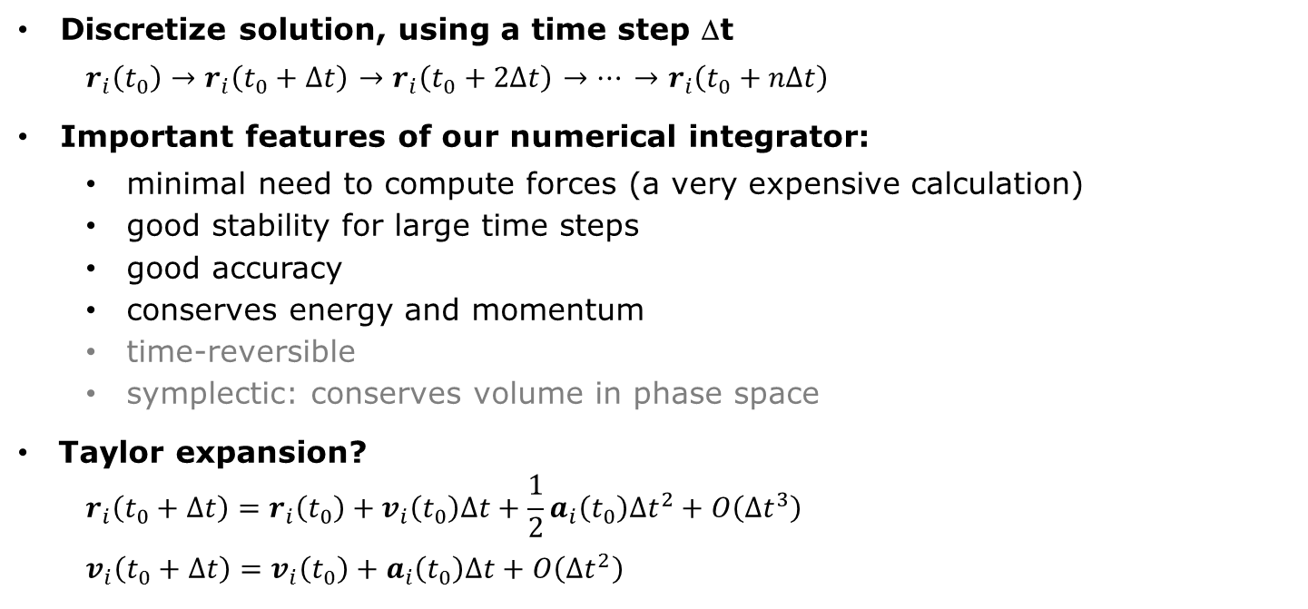
Molecular Dynamics
The basics II
Discretize solution, using a time step Δt
$r_{i}\left(t_{0}\right)→r_{i}\left(t_{0}+Δt\right)$ $→r_{i}\left(t_{0}+2Δt\right)$ $→⋯$ $→r_{i}\left(t_{0}+nΔt\right)$
Important features of our numerical integrator:
minimal need to compute forces (a very expensive calculation)
good stability for large time steps
good accuracy
conserves energy and momentum
time-reversible
symplectic: conserves volume in phase space
Taylor expansion?
$$r_{i}\left(t_{0}+Δt\right)=r_{i}\left(t_{0}\right)+v_{i}\left(t_{0}\right)Δt+\frac{1}{2}a_{i}\left(t_{0}\right){Δt}^{2}+O\left({Δt}^{3}\right)$$
$$v_{i}\left(t_{0}+Δt\right)=v_{i}\left(t_{0}\right)+a_{i}\left(t_{0}\right)Δt+O\left({Δt}^{2}\right)$$
Unstable and inaccurate!

Slide 35
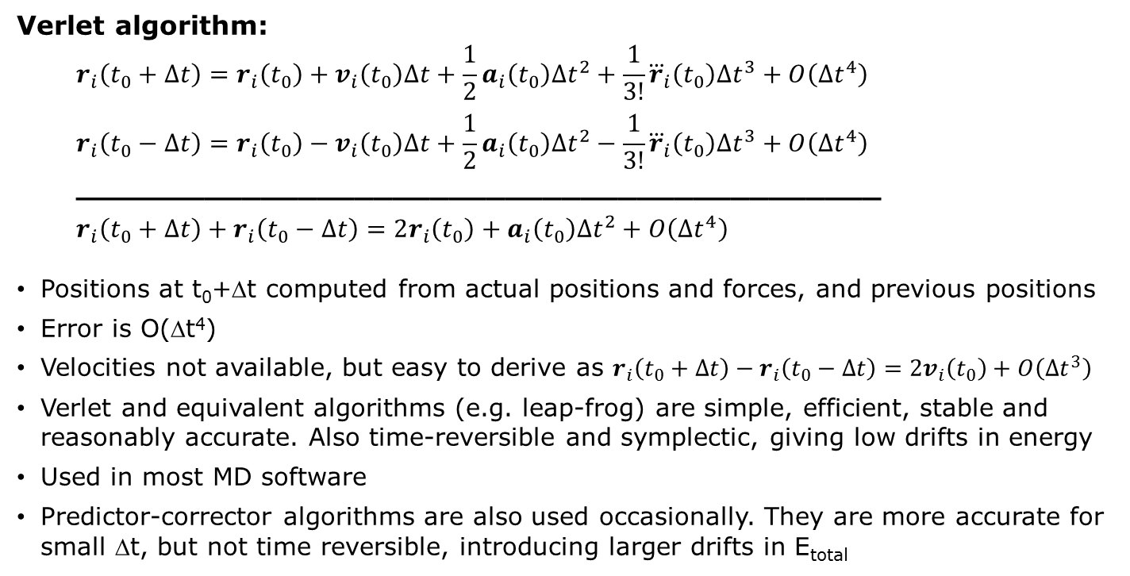
Molecular Dynamics
The basics III
Verlet algorithm:
$$r_{i}\left(t_{0}+Δt\right)=r_{i}\left(t_{0}\right)+v_{i}\left(t_{0}\right)Δt+\frac{1}{2}a_{i}\left(t_{0}\right){Δt}^{2}+\frac{1}{3!}{\overset{⃛}{r}}_{i}\left(t_{0}\right){Δt}^{3}+O\left({Δt}^{4}\right)$$
$$r_{i}\left(t_{0}−Δt\right)=r_{i}\left(t_{0}\right)−v_{i}\left(t_{0}\right)Δt+\frac{1}{2}a_{i}\left(t_{0}\right){Δt}^{2}−\frac{1}{3!}{\overset{⃛}{r}}_{i}\left(t_{0}\right){Δt}^{3}+O\left({Δt}^{4}\right)$$
___________________________________________
$$r_{i}\left(t_{0}+Δt\right)+r_{i}\left(t_{0}−Δt\right)=2r_{i}\left(t_{0}\right)+a_{i}\left(t_{0}\right){Δt}^{2}+O\left({Δt}^{4}\right)$$
Positions at t₀+Δt computed from actual positions and forces, and previous positions
Error is O(Δt⁴)
Velocities not available, but easy to derive as $r_{i}\left(t_{0}+Δt\right)−r_{i}\left(t_{0}−Δt\right)=2v_{i}\left(t_{0}\right)+O\left({Δt}^{3}\right)$
Verlet and equivalent algorithms (e.g. leap-frog) are simple, efficient, stable and reasonably accurate. Also time-reversible and symplectic, giving low drifts in energy
Used in most MD software
Predictor-corrector algorithms are also used occasionally. They are more accurate for small Δt, but not time reversible, introducing larger drifts in E_{total}

Slide 36
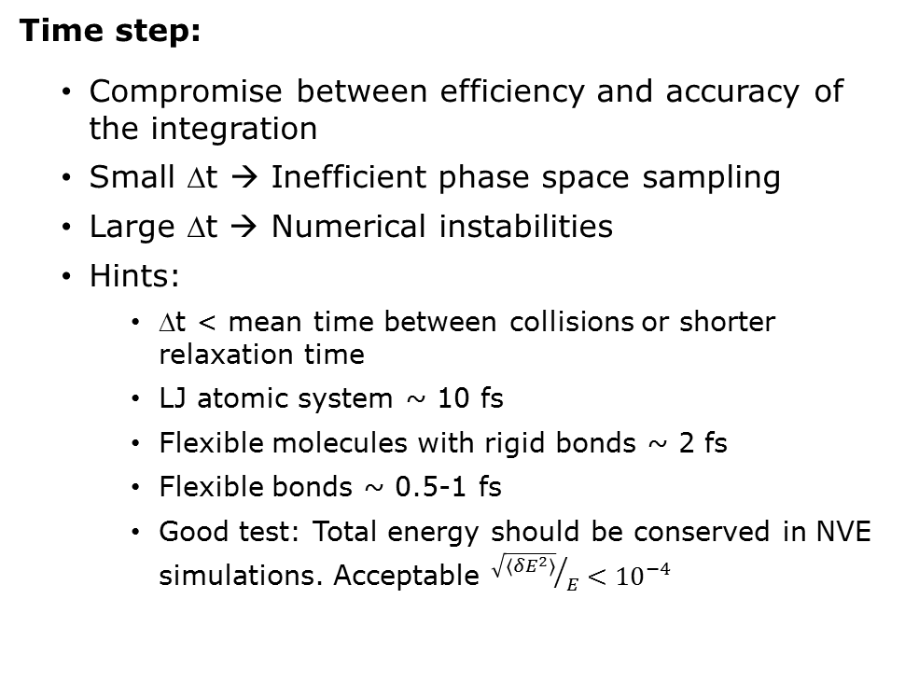
Molecular Dynamics
The basics IV
Time step:
Compromise between efficiency and accuracy of the integration
Small Δt → Inefficient phase space sampling
Large Δt → Numerical instabilities
Hints:
Δt < mean time between collisions or shorter relaxation time
LJ atomic system ~ 10 fs
Flexible molecules with rigid bonds ~ 2 fs
Flexible bonds ~ 0.5-1 fs
Good test: Total energy should be conserved in NVE simulations. Acceptable ${\sqrt{\left\langle {δE}^{2}\right\rangle }}/E<{10}^{−4}$
Frenkel & Smit: “Understanding molecular simulation”, Academic Press (2002)

Slide 37
Molecular Dynamics
The basics V
Periodic Boundary Conditions
Potential truncation
May need to ensure that forces (and not only energy) are 0 at R_{c}
Electrostatic forces
Thermodynamic ensembles
The integration of the equations of motion keeps constant N, V, and E (microcanonical ensemble)
Integration errors, force fluctuations and inconsistencies in the forces (e.g. generated by the cutoff) may cause slow drifts in the total energy: check E_{total} conservation!
E is constant in the NVE ensemble, but not K and U, so systems not in equilibrium will go to equilibrium while the temperature changes
Need to modify the Lagrangian or couple the system to a heat or pressure bath to keep T and/or P constant

Slide 38
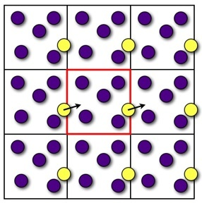
Monte Carlo
Practical aspects
Same as for Molecular Dynamics simulations
Use periodic boundary conditions (PBC) to avoid surface effects
Atoms in surface ~ N^{-1/3} (49% for a box containing 1000 atoms, 6% for 10⁶)
Need PBC to get bulk properties using a limited number of atoms
When an atom leaves the simulation cell, it is replaced by another with the same velocity, entering from the opposite cell face (N conserved)
Normally OK, but beware of artificial periodicity
Only allowed fluctuations: λ compatible with box length
Longest wavelength λ = L → problem if long wavelength fluctuations are important (e.g. phase transitions)
When simulating solids, the strain field generated by inhomogeneities will be artificially truncated and modified by the boundary
A macromolecule may interact with its own image if the box is too small → need to add layer of water sufficiently large
In some cases, spurious correlations may appear when dealing with charged or strongly polar solutes

Slide 39
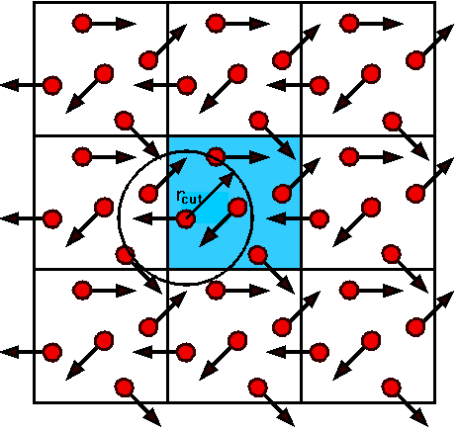
Monte Carlo
Practical aspects II
Potential truncation of non-bonding interactions
This is the most time-consuming part of the simulation
For bonding interactions → O(N)
For non-bonding interactions → O(N²)
Unfeasible to compute interactions with a very large number of images
Minimum image convention
Each atom only sees the closest image of the remaining N-1 atoms
“Truncation” surface not spherical
Or apply an spherical cut-off
Only interactions with atoms at r < R_{c} are considered
R_{c} < L/2. Typically
Introduces a discontinuity in energies and forces (for MD) at R_{c}. Often the potential is modified in order to bring it smoothly to 0 at R_{c} (switching function)

Slide 40
Monte Carlo
Practical aspects III
Treatment of long-range (electrostatic) interactions
Truncation method is not appropriate, as they extend beyond the primitive cell
Reaction Field:
Use spherical truncation and compute interactions for r < R_{c}
Beyond R_{c}, consider the medium as a dielectric continuum that will react to the dipole moment of the sphere given by r < R_{c}
-
+
+
-
-
+

Slide 41
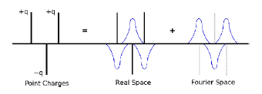
Monte Carlo
Practical aspects IV
Treatment of long-range (electrostatic) interactions
Compute the full lattice sum over the infinite set of images
Ewald sum:
Reference method, often in one of its particle-mesh variants (PME, SPME, PPPE)
At each point charge, add a Gaussian distribution of opposite sign to screen it
Screened charges can be treated in real space (short-range interactions)
Compensating Gaussian distribution treated in reciprocal space

Slide 42
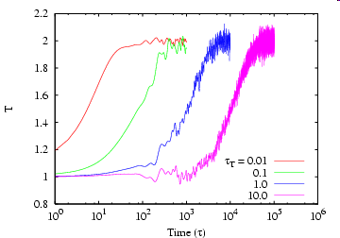
Molecular Dynamics
The basics VI
Thermodynamic ensembles
Several thermostats allow to do NVT simulations: velocity scaling, Berendsen, Andersen, Nosé-Hoover, but not all of them sample strictly the correct thermodynamic ensemble.
There are also different barostats to do NPT simulations.
Berendsen: Simple, fast response and flexible, but no canonical ensemble
Nosé-Hoover: Extended lagrangian. Sample correct canonical ensemble, but goes to T_{ref} in an oscillatory way (poorer T control)

Slide 43
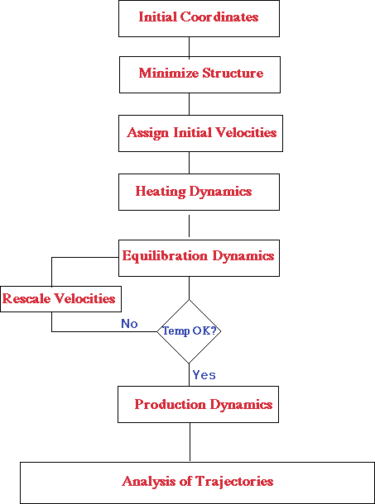
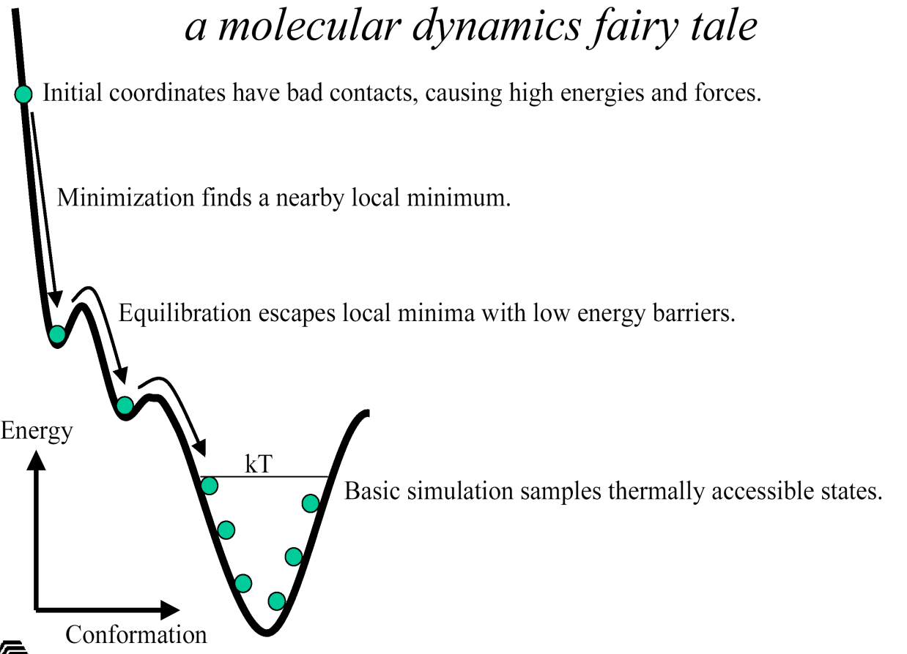
Molecular Dynamics
Protocol
From J. Phillips, Beckman Inst., UIUC
http://www.ks.uiuc.edu

Slide 44
Analysis of MD simulations

Slide 45
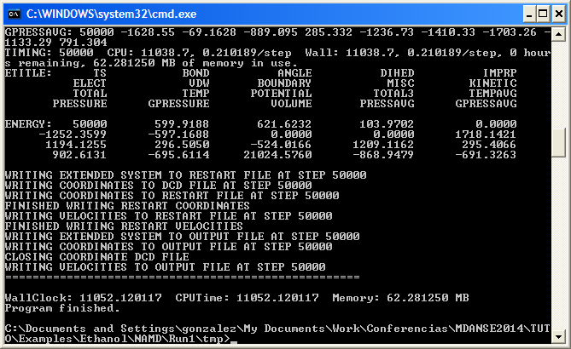
Once our MD run is over …
Snapshot of the final state of the system
Trajectory file containing positions (and velocities, if requested) at selected intervals
File containing thermodynamic information (T, P, energies, etc.)
Did everything go well?
Can I get the information I’m looking for?

Slide 46
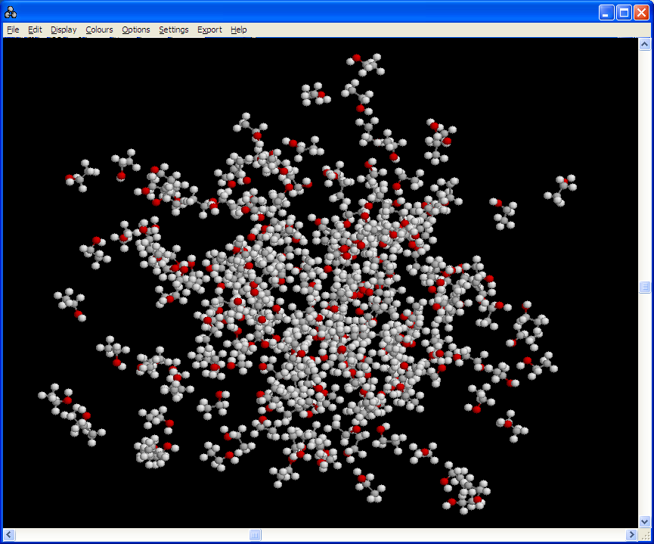
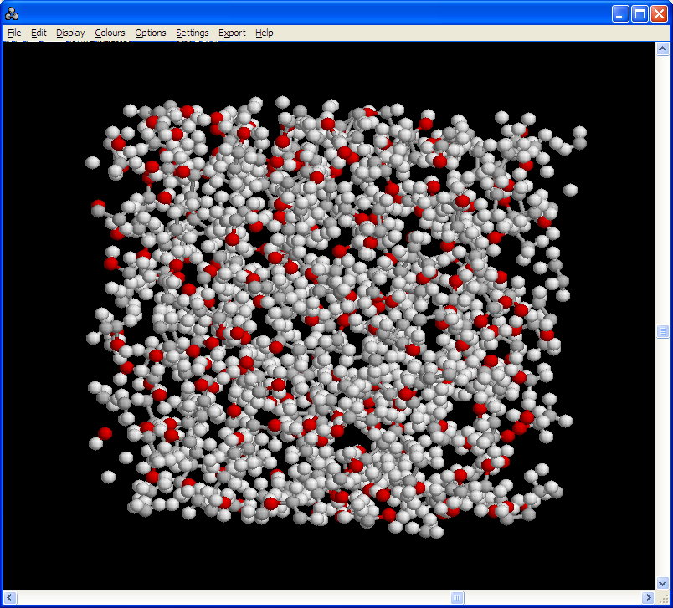
Once our MD run is over …
Visual checking of last configuration:
Many visualization tools available (VMD, Rasmol, MDANSE, …)
Don’t be puzzled by PBC’s (remember that the simulated system is really an infinite replica of images of the primary box)
Are molecular geometries reasonable?
Are there pairs of atoms that come ‘too close’ to each other?

Slide 47
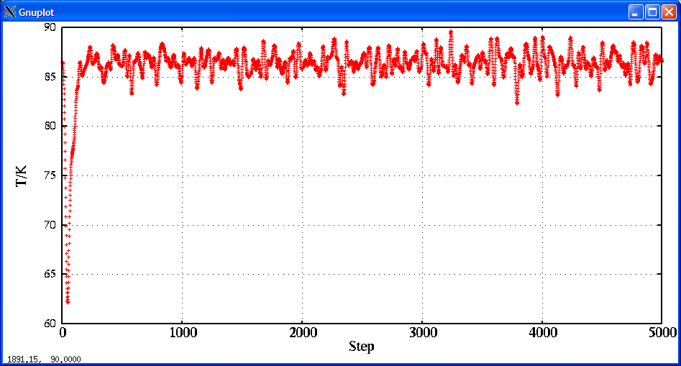
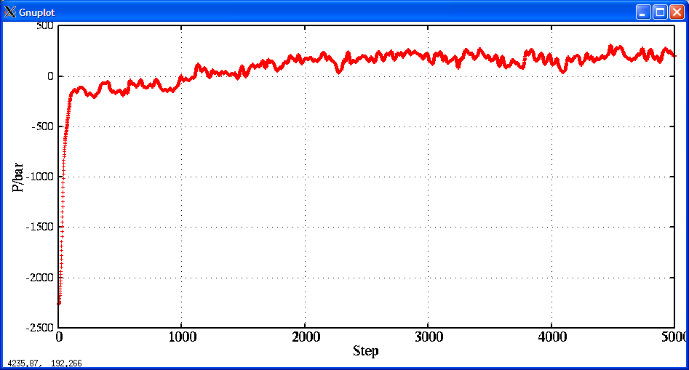
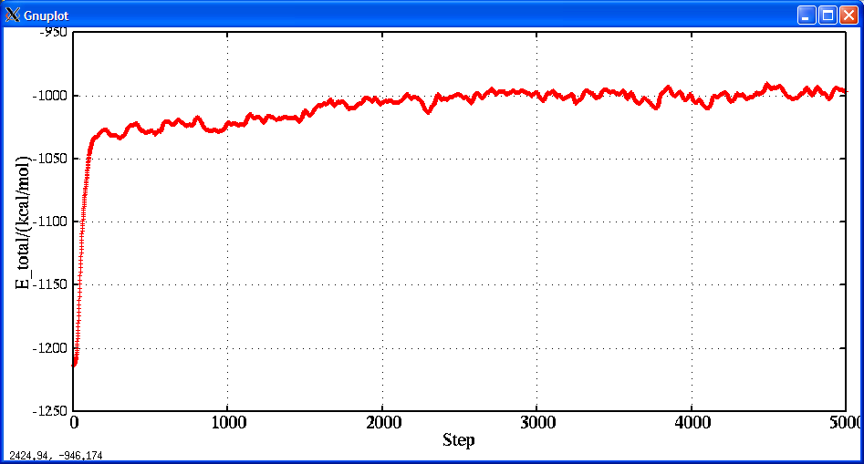
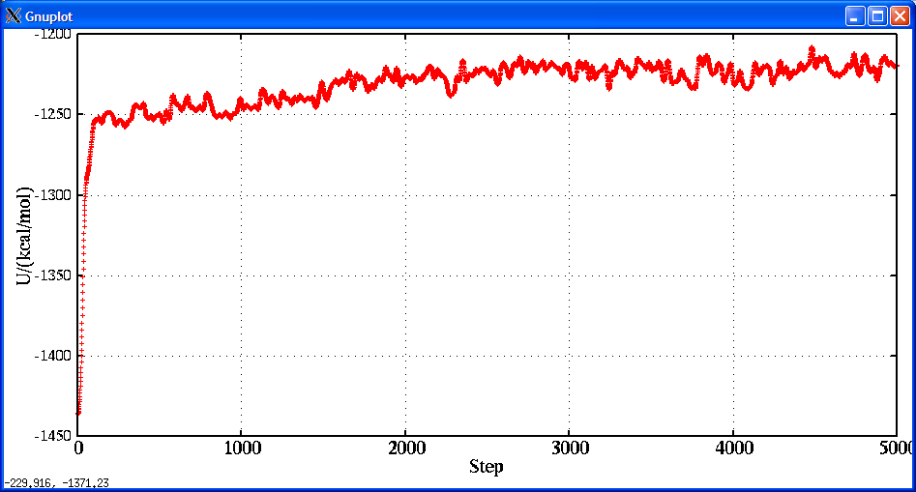
Once our MD run is over …
Is the system well equilibrated?
Not all the properties converge at same speed

Slide 48
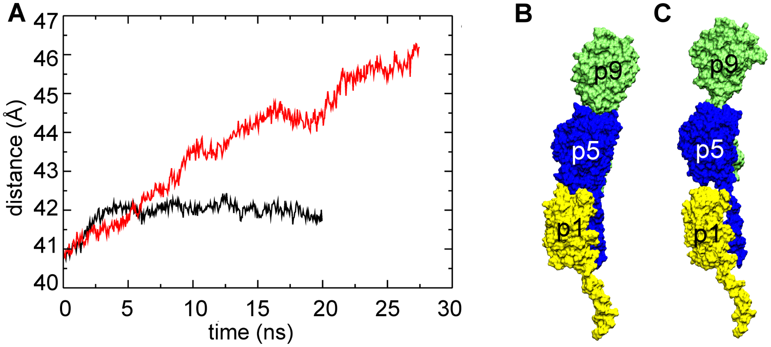
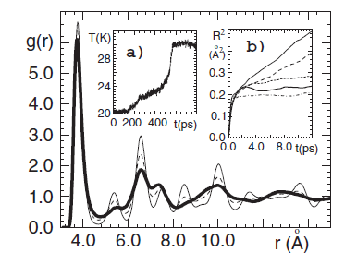
Once our MD run is over …
Baker, PLOS Comp. Biol. (2013)
Does the system change during the simulation?
De Santis, JPCM 14 (2002)
Durandurdu, JPCM 21 (2009)

Slide 49

Thermodynamic averages
Does our model give reasonable average values for T, P, density, …?
T, P, V, energy contributions are usually directly given by the MD code
Other thermodynamic properties may need to be calculated later
If possible, compare with as much experimental data as possible
Note that formulae based on fluctuations depend on the ensemble
Abascal & Vega, JCP (2005)
(NVT)
(NVE)
H₂O

Slide 50


Structural properties
The static structure factor can be easily calculated and compared to neutron or x-ray diffraction data
Liquid argon

Slide 51


Dynamical properties
The mean square displacement (total or for a particular atom) can be easily calculated and provides a direct way to compute the self-diffusion coefficient (available e.g. from NMR, QENS or tracer diffusion)
u²(t) can be calculated over different time origins, but the number of origins decreases with t, so error in u²(t) will increase with time

Slide 52




Dynamical properties
Time correlation functions
Velocity autocorrelation function
Van Hove self and distinct correlation functions
Intermediate (coh and inc) scattering functions
…
→ $D=\frac{1}{3}\int{C_{vv}\left(t\right)dt}$
→ Can be compared to VDOS measured by INS
G_{s}(r,0) = δ(r)
G_{s}(r,t →∞) → 1/V
G_{d}(r,0) = ρg(r)
G_{d}(r,t →∞) → ρ

Slide 53
Error analysis
Systematic errors
Numerical integration, finite-size effects, cut-off
Intrinsic and reproducible
For errors due to the interaction cut-off, long-range corrections can be included in some cases by assuming a uniform distribution beyond r_{c}
Errors due to inadequate sampling
If ergodic hypothesis does not hold
Not reproducible
Statistical errors
Random fluctuations in measurement
Usual statistical analysis can be applied, but beware of correlations between points

Slide 54


Error analysis
Error in correlated measurements
If we evaluate a given property X at different times, we can use standard statistical methods to compute ⟨X⟩ and σ_{X}. But contrary to most experimental data, our X_{i} “measurements” are likely to be highly correlated, making σ_{X} to be underestimated
The correct variance can be computed as
$$σ^{2}\left(\left\langle X\right\rangle \right)=\frac{1}{M}\sum_{i=1}^{M}{{\left(X_{i}−\left\langle X\right\rangle \right)}^{2}}×\left[1+2\sum_{μ}{\left(1−\frac{μ}{M}\right)∅_{μ}}\right]$$
$$∅_{μ}=\frac{\left\langle X_{μ}X_{0}\right\rangle −{\left\langle X\right\rangle }^{2}}{\left\langle X^{2}\right\rangle −{\left\langle X\right\rangle }^{2}}$$
with

Slide 55

Error analysis
Error in correlated measurements: Block averaging method
Flyvbjerg and Petersen, J. Chem. Phys. 91, 461 (1989)
Calculate averages over M_{b} blocks of increasing size b
As b increases, the blocks are less correlated until they become statistically independent. Then a plateau is observed which gives us the correct σ

Slide 56



Error analysis
Error in time correlation functions
Zwanzig and Ailawadi, Phys. Rev. 182, 280 (1969)
For an autocorrelation function $C_{X}^{MD}\left(t\right)={\left\langle X\left(t_{0}+t\right)X\left(t_{0}\right)\right\rangle }_{MD}$, assuming that X(t₀) is a Gaussian random variable, the variance is
$${ σ}^{2}\left({\left\langle X\left(t_{0}+t\right)X\left(t_{0}\right)\right\rangle }_{MD}\right)≈\frac{2τ_{X}C_{X}^{2}\left(0\right)}{t_{MD}}$$
And for a normalized a.c.f.
$$σ\left(\frac{{\left\langle X\left(t_{0}+t\right)X\left(t_{0}\right)\right\rangle }_{MD}}{{\left\langle X^{2}\right\rangle }_{MD}}\right)≈\sqrt{\frac{2τ_{X}}{t_{MD}}}×\left(1−C_{X}^{MD}(t)\right)$$
E.g.: $\frac{t_{MD}}{τ_{X}}=1000 ⇒ σ≈0.04 (\text{for} t≫τ_{X}, \text{so}{ C}_{X}^{MD}(t)≈0)$
$\frac{t_{MD}}{τ_{X}}=100 ⇒ σ≈0.14$
$\frac{t_{MD}}{τ_{X}}=10 ⇒ σ≈0.45$
$$τ_{X}:\text{Mean} \text{relaxation} \text{time} \text{for} \text{X},$$
$t_{MD}:\text{Total} \text{simulation} \text{time}$
But things are much better for single-particle c.f.:
$$σ≈\sqrt{\frac{2τ_{X}}{Nt_{MD}}}$$

Slide 57

Comparing to neutron scattering data
G. R. Kneller et al.: “nMOLDYN: A program package for a neutron scattering oriented analysis of Molecular Dynamics simulations”, Comp. Phys. Comm. 91, 191 (1995)

Slide 58






Comparing to neutron scattering data
Think carefully how measured and computed quantities are exactly determined
Morelon,
JCP(1998)

Slide 59


Comparing to neutron scattering data
From Tobias, Faraday Discuss. (2009)

Slide 60




Comparing to neutron scattering data
MD: MSD computed directly as $u^{2}\left(t\right)=\left\langle {\left[r\left(t_{0}+t\right)−r\left(t_{0}\right)\right]}^{2}\right\rangle$
Neutron scattering: MSD from elastic intensity via DW $I_{el}≈e^{−Q^{2}{u(t)}^{2}}$
Can not compare the msd directly obtained from MD.
Instead compute I(Q,t) → S(Q,ω) → S(Q,ω) ⊗ R(ω) and then follow same procedure as for experiment.

Slide 61

Comparing to neutron scattering data
Standard MD treats nuclei as classical particles (for both empirical and AIMD)
Computed correlation functions are classical correlation functions
Limits in computed S(Q,ω):
Quantum nature of the simulated system must be negligible (otherwise need to consider methods of incorporating quantum mechanics in the simulation, e.g. using PIMD)
$ℏω≪k_{B}T$, so care when interpreting high-frequency features or low temperature studies (For $T=298 K⇒ν≈200{ \text{cm}}^{−1} \left(25 \text{meV}\right), τ≈0.2 \text{ps})$
Recoil effect on scattering atom must be negligible (Kneller, Mol. Phys. 83, 63 (1994)), so $\frac{ℏ^{2}Q^{2}}{2M_{I}}≪k_{B}T$
Analysis soft use tabulated bound coh and inc neutron scatt lengths

Slide 62
Useful software to analyze MD simulations
Neutron observables
MDANSE (E. Pellegrini, ILL): https://mdanse.org
Sassena (ORNL): www.sassena.org
LiquidLib (Illinois): https://github.com/Shopify/liquid/tree/master/lib/liquid
Other
VMD (Illinois): http://www.ks.uiuc.edu/Research/vmd/
MDTraj: http://mdtraj.org
Travis (Bonn, Lepizig): http://www.travis-analyzer.de/
…
+ scripts and programs distributed with MD codes
+ tools for specific analysis (bio, ring statistics, H-bonding, etc.)

Slide 63
Validation of MD results
W. F. van Gunsteren and A. E. Mark: “Validation of molecular dynamics simulation”, J. Chem. Phys. 108, 6109 (1998)
W. F. van Gunsteren, J. Dolenc and A. E. Mark: “Molecular simulation as an aid to experimentalists”, Curr. Opin. Struct. Biol. 18, 149 (2008)
Some important points to consider:
Quality of the model
Accuracy of the force field
Degree of sampling, statistics and convergence
Quality of the software
Competence in using the software

Slide 64
Validation of MD results
MD simulations are normally validated by comparing to experiment, but:
Simulation and experiment can agree because
The simulation reflects adequately our system
The property compared is not sensitive to simulation details
Compensation of errors
Or simulation and experiment may not agree because
The simulation does not provide an adequate representation of our system (e.g. due to one or several of the 5 previous points)
The experimental data are not correct

Slide 65


Validation of MD results
Quality of the model
Tarek & Tobias, JACS (1999)

Slide 66
My main references
Among many other useful material
DFT
“Electronic Structure: Basic Theory and Practical Methods”, Richard M. Martin, Cambridge University Press (2004)
LD
“Structure and dynamics: An atomic view of materials”, Martin Dove, Oxford University Press (2003)
MC and MD
“Computer Simulation of Liquids”, M. P. Allen and D. J. Tildesley, Clarendon Press, Oxford (1987)
“Understanding Molecular Simulation: From Algorithms to Applications”, D. Frenkel and B. Smit, Academic Press (2002)
School lectures from the French Neutron Society
“Neutrons and simulations”, M. Johnson, N. Malikova, and M. Plazanet (eds), EDP sciences: https://www.neutron-sciences.org/articles/sfn/abs/2011/01/contents/contents.html

Slide 67
The end

